Slide 1



Background Processing
Hangfire v Microsoft Logic Apps
Notes:
Background Processing
Hangfire and Microsoft Logic Apps
Hangfire doesn’t really have a logo so I made one.

Slide 2


Joel Viney
Team Lead at QuillGroup
Software developer for 20 years
Developing Azure on and off 4 years
https://github.com/JoelViney
Notes:
QuillGroup Accounting, Financial Planning and Superannuation services in Southport and Brisbane
I’ve been developing professional for 20+ years
Dabbled with Azure on and off for 4 years
I’ve had to deal with background processing, batch jobs for that entire time
I skipped the wedding profile photo this time…

Slide 3
Background Processing
Azure Scheduler
“Azure Scheduler will retire on September 30, 2019”
Azure Logic Apps
“Azure Logic Apps is a cloud service that helps you automate and orchestrate tasks, business processes, and workflows when you need to integrate apps, data, systems, and services across enterprises or organizations”
Hangfire
“An easy way to perform background processing in .NET and .NET Core applications. No Windows Service or separate process required. Backed by persistent storage. Open and free for commercial use.”
Notes:
Background processing, background jobs, scheduled tasks, cron jobs what ever you want to call them.
Azure Scheduler is dead
So where does that leave us?
I am going to do this by going over two products in the industry right now that seem like the obvious choices.
Azure Logic Apps
“Azure Logic Apps is a cloud service that helps you automate and orchestrate tasks, business processes, and workflows when you need to integrate apps, data, systems, and services across enterprises or organizations”
Hangfire
“An easy way to perform background processing in .NET and .NET Core applications. No Windows Service or separate process required. Backed by persistent storage. Open and free for commercial use.”

Slide 4
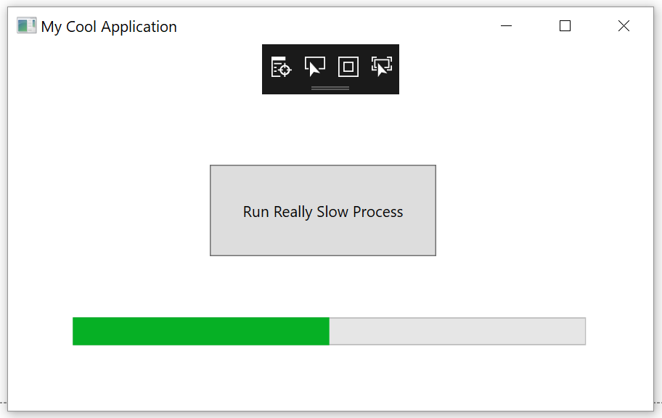
My History with Background Processing
Button -> Manually Triggering Job
Windows Scheduler
Windows Service
Azure Scheduler -> Azure Job
Azure Scheduler -> Http Endpoint
Azure Scheduler -> ServiceBus -> Azure Job
Hangfire
Notes:
Scheduling background jobs is something that every developer will come across at some stage.
I’m going to go through each one and give my opinion, your results may vary.
In the past I've used or worked on:
* Manually triggering a batch job at the start of the day.
+ Easy-ish to write you still need progress bars
- Annoying for the end user
+ Session timeout issues for web based applications
* Windows Scheduler (to trigger an exe)
- Double the Installation - Issues keeping your production / job code synchronized.
- I just felt dirty
* Windows Service
- Installation is a pain in the ass
- Double the Installation - Issues keeping your production / job code synchronized.
* Azure Scheduler -> Azure Jobs
+ Easy-ish Installation, there is a bit of dicking around with logging
- Double the Installation - Issues keeping your production / job code synchronized.
* Azure Scheduler -> Triggering an http endpoint
+ Easy Installation
- Session timeout issues?
- Security issues
- Uses websites resources
Azure Scheduler -> Azure Service Bus
+ Complex, so god damn complex
- All the limitations of Azure Jobs
* Hangfire
+ Easy to install
- Uses websites resources
You can sort of see where this presentation is going.

Slide 5

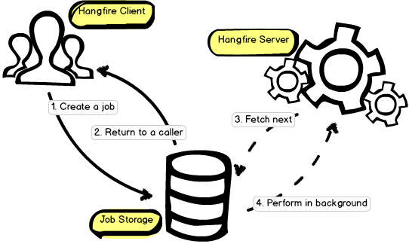
https://www.hangfire.io/
What is it? Simple scheduling
Uses your websites / apps resources
Open Source -> LGPL 3.0
.Net 4.5 and .Net core
Persistence: InMemory, SQL Server
or Redis (paid only)
Will scale out
Automatic Retry
IOC
Stops free Azure tier sites going to sleep
Notes:
What is Hangfire? Not much to it really…. It just does scheduling in a simple way!
You program it in your application, and it uses your websites / applications resources.
Negative to this is it may impact your websites performance with too many heavy jobs.
If that becomes a problem you can created a dedicated website / app to process the jobs.
The advantage of this over creating an azure function or webjob…. You are already deploying a website, now your just deploying 2.
Open Source -> you can use it for free LGPL 3.0. Use it for free, including it with your commercial applications.
Supports 4.5 and core
Storage: InMemory, Sql Server, Sql Server Express, Azure Sql Database and Redis (paid version only)
It will scale out if you decide to run multiple instances of your website
Will scale out, multiple using websites work fine.
Built in retry for jobs
It uses your IOC so no need to get complex. Autofac + .net cores built in.
If anyone runs any free Azure sites, they can take a while to wake up, over the last week I’ve noticed that one running Hangfire just don’t go to sleep. I will need to play with this a bit more to see if there is any real cost involved but it’s potentially a good hack.

Slide 6
Hangfire Installation
Notes:
Easy to install… Mostly. I found the documentation is a bit rough for .net core and it took me a couple of cracks at it. But I’ve done the hard work here for you.

Slide 7
Hangfire Console

Slide 8
Hangfire – Job Types
asdasd

Slide 9
Hangfire Dashboard

Slide 10

“In 2016, we launched Azure Logic Apps, which includes the ability to configure and run scheduled jobs as well as advanced workflow features other stuff.”
Microsoft Flow
Workflow engine
Notes:
In 2016, we launched Azure Logic Apps, which includes the ability to configure and run scheduled jobs as well as advanced workflow features.
Workflow engine

Slide 11


Slide 12
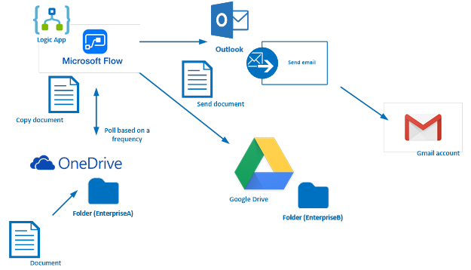
Azure Logic Apps
Notes:
"Automate many of the workflows you have in place, without writing a single line of code"

